Slide 1
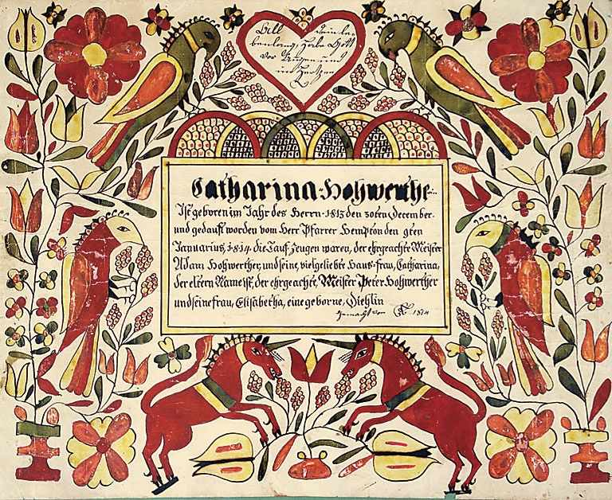
Fraktur

Slide 2
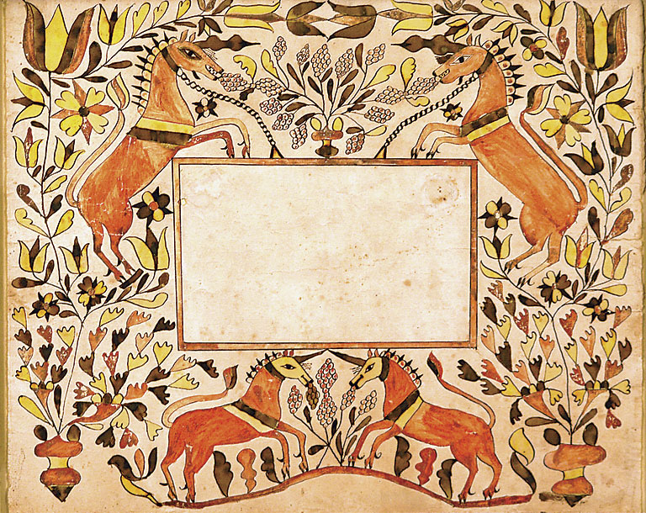
“Fraktur” are colorful documents designed by the Pennsylvania Germans who lived in rural parts of southeastern Pennsylvania and the surrounding region during the 1700s and 1800s.

Slide 3
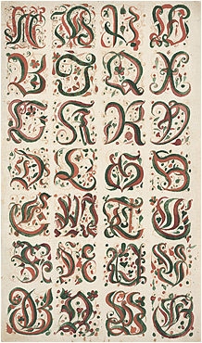
Most fraktur are personal records, such as birth and baptismal certificates or marriage certificates.

Slide 4
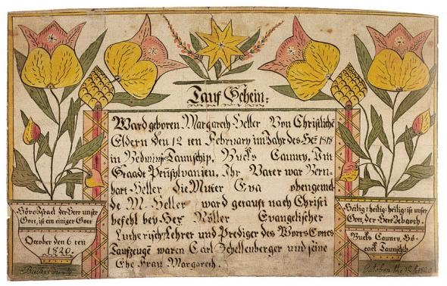
Artists often decorated these documents with drawings of flowers or birds.

Slide 5
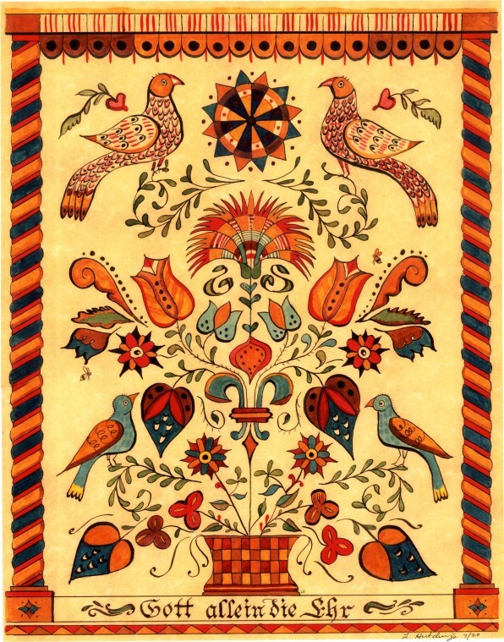
Typical Pennsylvania-German Fraktur was designed using vivid tones of blue, yellow, green, and red.

